Slide 1
阿里代码缺陷检测探索与实践
刘力华（息羽）

Slide 2
01 Team Introduction
02 Exploration & Achievements
03 Challenges
04 Cooperations
目 录
Catalog

Slide 3
Research Efficiency Business Department

Slide 4
Research & Development Collaboration Platform
Project
Management
Programming
Test
Release
Feedback
Intelligent Supporting Platform
Product
Operation
Aone
AI
Intelligent Q&A
Code Evolution
AIOps
Data Mining

Slide 5
Research & Development Collaboration Platform

Slide 6
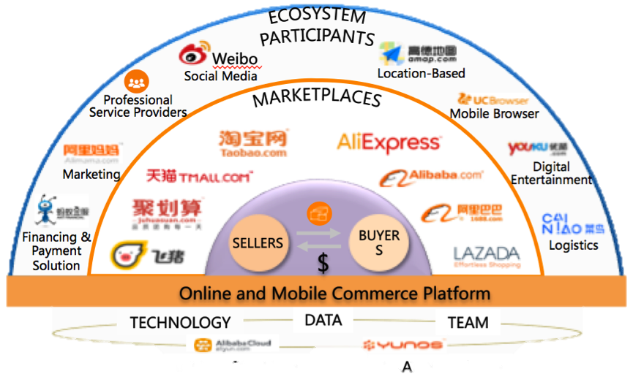
Alibaba Code Center
Alibaba Code Center

Slide 7
Code Intelligence
平台业务
代码评审
代码分享
代码搜索
代码管理
代码开发
智能赋能
开发质量
开发效率
缺陷检测
代码推荐
Code Clone
代码补全
代码摘要
Commit摘要
代码演进
优质代码
……
数据支撑
代码图谱

Slide 8



Commit Defect Detection
Backgroud
Increasing scale of software and source code
Increasing software commits in one day
Increasing requirement for software quality
Objective
Mining code value
Improving code review efficiency
Reducing system failure

Slide 9
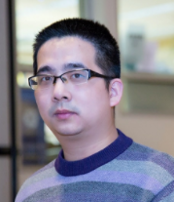
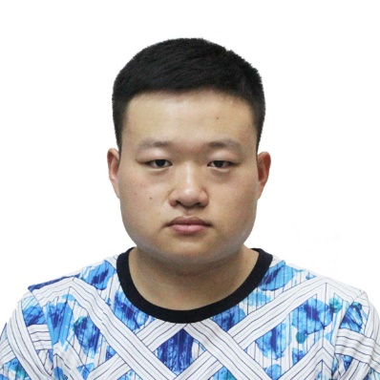

Commit Defect Detection Cooperation
Xin Xia
Meng Yan
Guanbao Yang (孤尽)
Lihua Liu (息羽)
Zhejiang University
Alibaba Code Center

Slide 10
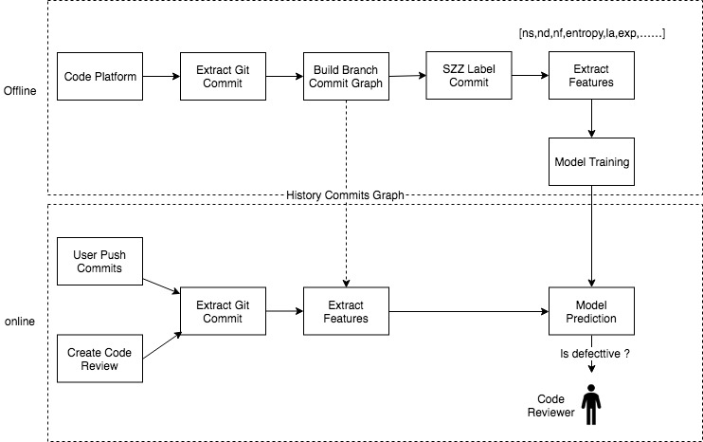
Commit Defect Detection

Slide 11
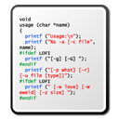


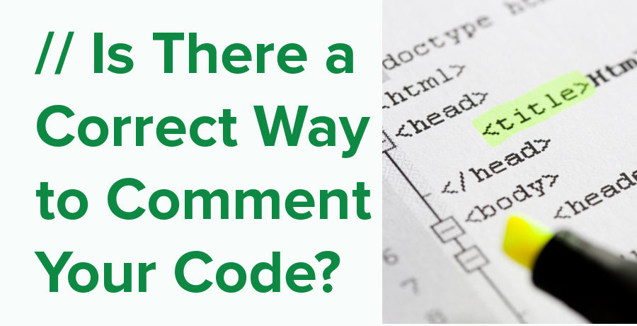
Defect Commit Labeling
Step 1
Identifying bug-fix changes by commit message’s keywords
Step 2
Identifying
bug-introducing lines by commit diff
Step 3
Backtracking bug-introducing lines
Step 4
Labeling bug-introducing changes

Slide 12
Commit Defect Features
Diffusion:
Capture the distribution of the change
e.g., #Subsystems, #Directories, #Files
Size:
Capture the size of a change
e.g., LT, LA, LD
Purpose:
Capture the purpose of a change
e.g., is bug-fix or not
History:
Capture the historical information
e.g., NDEV, NUC
Experience:
Capture the experience of the submitter
e.g., #changes by the submitter

Slide 13
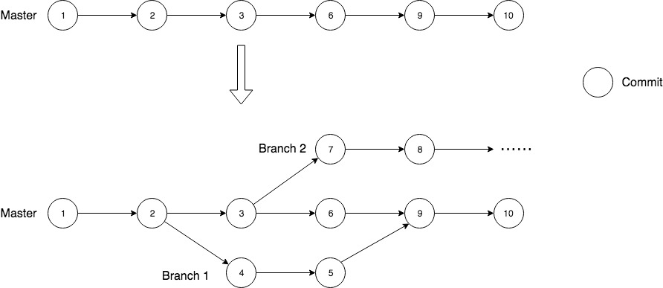
Feature Extraction Improvement

Slide 14
Commit Defect Detection Metrics
1W+ Projects, 200W+ Commits, 3W+ Buggy Commits
Single Project Dataset: Training independent models for each project.
Multi-Project Dataset: Training only one model for all projects.

Slide 15
Commit Defect Detection Metrics

Slide 16
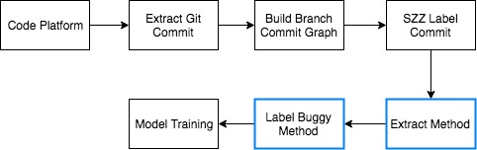
Method-Level Defect Detection

Slide 17
code2vec (PathAttention)
Uri Alon, Meital Zilberstein, Omer Levy, and Eran Yahav. 2018. code2vec: Learning Distributed Representations of Code
Model Input Tensor Shape:
Start: (Batch Size, Tuples Size)
End: (Batch Size, Tuples Size)
Path: (Batch Size, Tuples Size)
Context Tuples（<Start, Path, End>）：
1、⟨elements, (Name↑ FieldAccess↑ Foreach↓ Block ↓ IfStmt↓ Block ↓ Return↓ BooleanExpr), true⟩
2、⟨Target, (VarDeclId ↑ Parameter ↑ MethodDecl↓ Block ↓ Return↓ BooleanExpr), false⟩
3、⟨boolean, (Primitive↑ MethodDecl ↓ Name), ?⟩
4、⟨Object, (Class ↑ Parameter ↓ VarDeclId), target⟩
……

Slide 18
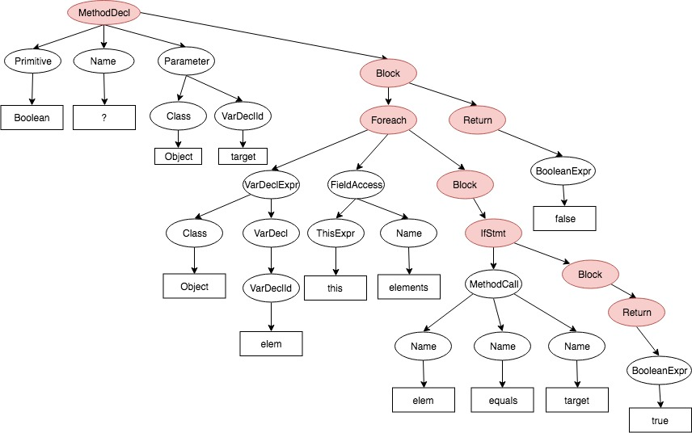
LinePathAttention Model
Cut-off Node | Example
Statement | IfStmt, Foreach, Return, BreakStmt, WhileStmt, SwitchStmt, ExpressionStmt, Block, ……
Declaration | ClassOrInterfaceDeclaration, MethodDeclaration, FieldDeclaration, ……
Encoding Style (<Start, Path, End>):
<this, (ThisExpr↑FieldAccess↓Name)>, elements>
<Object, (Class↑Parameter↓VarDeclId), target>
<elem, (Name↑MethodCall↓Name), equals>
……
Model Input Tensor Shape:
Start: (Batch Size, Line Size, Tuples Size)
End: (Batch Size, Line Size, Tuples Size)
Path: (Batch Size, Line Size, Tuples Size)
Encoding Style (<Terminal, Path>):
<this, (ThisExpr↑FieldAccess↑Foreach)>
<elements, (Name↑FieldAccess↑Foreach)>
<Object, (Class↑Parameter↑MethodCall)>
<target, (VarDeclId↑Parameter↑MethodCall)>
……
Model Input Tensor Shape:
Terminal: (Batch Size, Line Size, Tuples Size)
Path: (Batch Size, Line Size, Tuples Size)

Slide 19
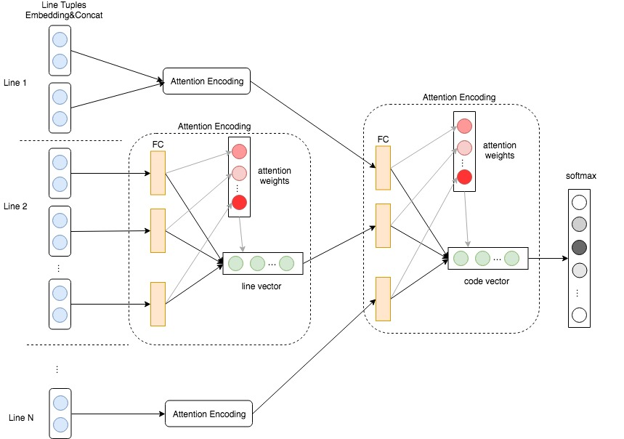
LinePathAttention Model

Slide 20
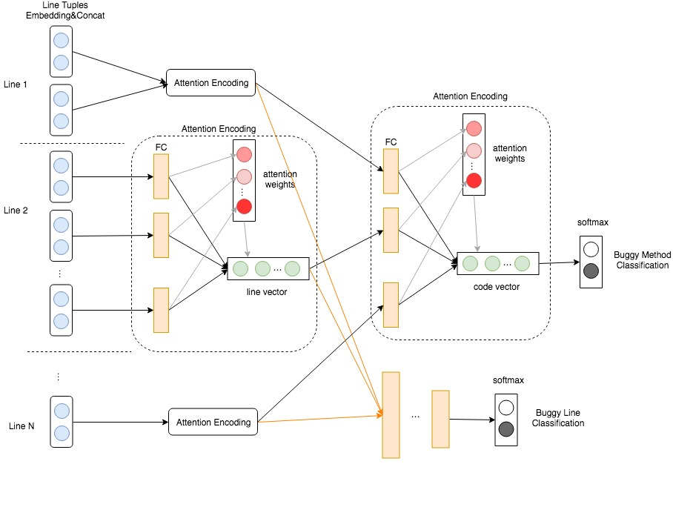
Multi-Task LinePathAttention Model
Commit Example:
Method modified in diff:
Is Bug ?
Lines modified in diff:
Is Bug ?

Slide 21
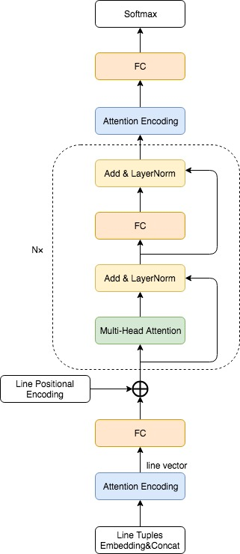
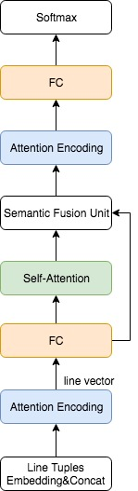

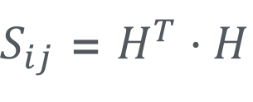

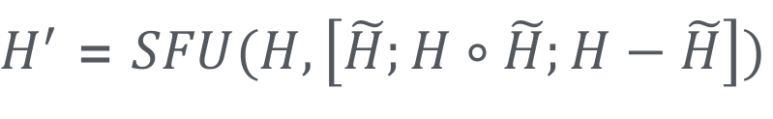
More Models
Self-Attention SFU Model
Transformer Model
$$H=ReLu(W^{T}u^{Line})$$
$S_{ij}$ = $H^{T}·H$
$$\tilde{H}=softmax\left(S_{i:}\right)·H$$
$H^{′}$ = $SFU(H,\left[\tilde{H};H∘\tilde{H};H−\tilde{H}\right])$

Slide 22
Model Metrics
Model | F1 | AUC
code2vec (PathAttention) | 0.59 | 0.63
LinePathAttention | 0.62 | 0.67
CNN + LSTM + SFU + Attention | 0.67 | 0.63
LinePathAttention + Self-Attention + SFU | 0.60 | 0.69
LinePathAttention + Transformer | 0.68 | 0.67

Slide 23
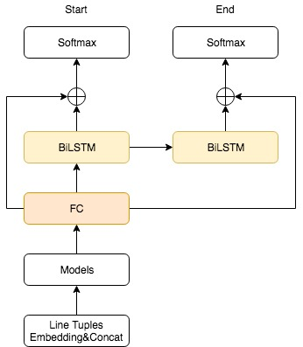
Boundary Model
Method Fix Diff
Method Start/End Labeled

Slide 24
DSL Transformation
Flat and Easy to parse
<LineNumber> <KeyWord> <Arguments>…
717 ARG @PARA_String 717 CAL @PARA_Map containsKey @RETURN_VAR1 717 CHK @RETURN_VAR1 718 ARG @PARA_String 718 CAL @PARA_Map get @RETURN_VAR2 718 ASS @PARA_String @RETURN_VAR2
-------------void readFile(String)--------------- 92 PAR String @PARA_String 93 PAR @PARA_String 93 ASS @PARA_String LITERAL 95 PAR @PARA_FileReader 95 ASS @PARA_FileReader ObjectCreationExpr 96 PAR @PARA_BufferedReader 96 ASS @PARA_BufferedReader ObjectCreationExpr 97 PAR @PARA_String 98 PAR @PARA_StringBuilder 98 ASS @PARA_StringBuilder ObjectCreationExpr 99 CAL @PARA_BufferedReader readLine @RETURN_VAR0 99 ASS @PARA_String @RETURN_VAR0 99 EQU @PARA_CONST != NULL @RETURN_VAR1 99 CHK @RETURN_VAR1 100 ARG @PARA_String 100 CAL @PARA_StringBuilder append @RETURN_VAR2 101 ARG LITERAL 101 CAL @PARA_StringBuilder append @RETURN_VAR3 103 CAL @PARA_StringBuilder toString @RETURN_VAR4 103 ARG @RETURN_VAR4 103 CAL @PARA_UNRESOLVED_TYPE println @RETURN_VAR5

Slide 25
Challenges
部分缺陷仅从静态代码层面难以分析
数据集SZZ标注噪音太多
模型效果还无法大规模商用
缺陷种类较多，单模型/方法无法完全覆盖

Slide 26
Cooperations
期望利用更多维度数据
期望有改进SZZ算法的方法
期望能有方法能划分缺陷的类别
与高校共建工业界Benchmark

Slide 27
感谢观看
thanks

